Slide 1
“Puzzles in Consumer Financial Behaviour” - Ben Guttman-Kenney

Slide 2
Two Fantastic Papers
Why `co-hold’ ~0% cash and ~15% credit card debt?
Not inattention.
Co-holders prefer to pay with debit vs. credit cards.
2. Effect of stock ownership on spending?
- Large & persistently.
1. Marketing studying Economics
2. Economics studying Marketing

Slide 3
Effect of Stock Ownership on Individual Spending and Loyalty
- Medina, Mittal, & Pagel

Slide 4
Take Equity?

Slide 5
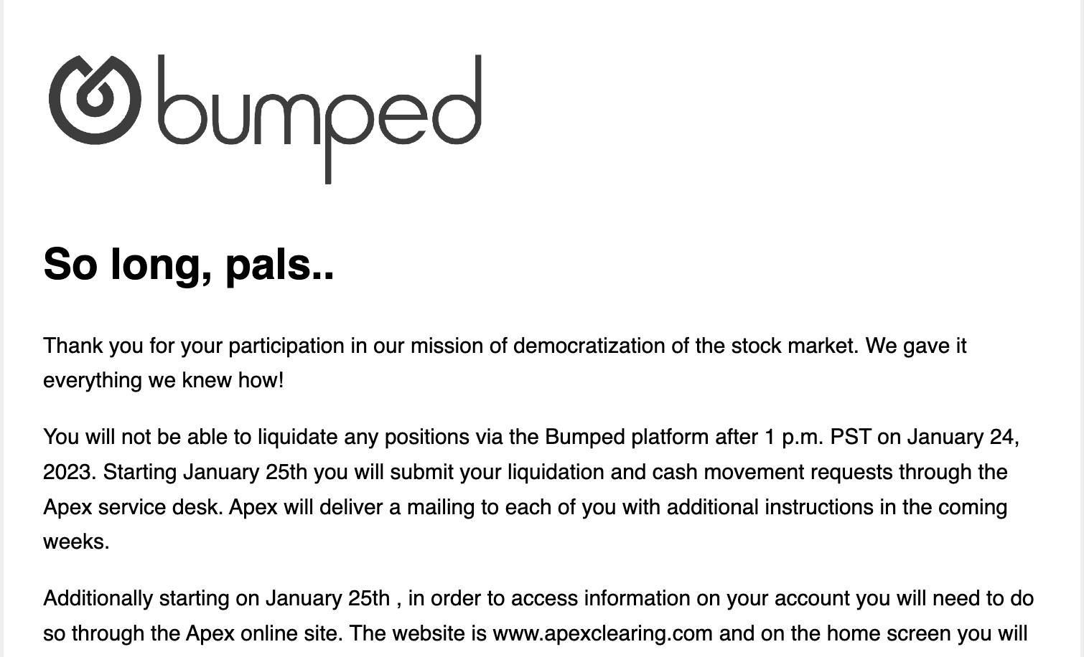
RIP Bumped (2017 – 2022)
Why failed?

Slide 6
RIP Bumped (2017 – 2022)
Why failed?
One potential reconciliation:
~6,000 consumers remaining on app: ⬆️ ~3,300%
Why remain on app if don’t use? 80% don’t.
~27,000 consumers in total. Others 0s?: ⬆️ ~700%

Slide 7
Dream Big!
Were consumers optimizing ex-ante / ex-post?
What should firms do? Cash, coupons, points, stocks, 🧸
If offer stocks, what is optimal size? Paper argues price inelastic.
⬆️ retail investors spending → ⬆️ retailer’s stock price volatility?
What should governments do? E.g. Consumer-financed fiscal stimulus (Ding et al. 22 WP), Eat-Out-To-Help-Out (Fetzer 21 EJ)
Can this speak to old literature on taking risks over small stakes? (e.g. Arrow 71, Rabin 00)

Slide 8
The Psychology of co-holding: Why some choose to simultaneously save and borrow
- Batista, Mao, & Sussman

Slide 9
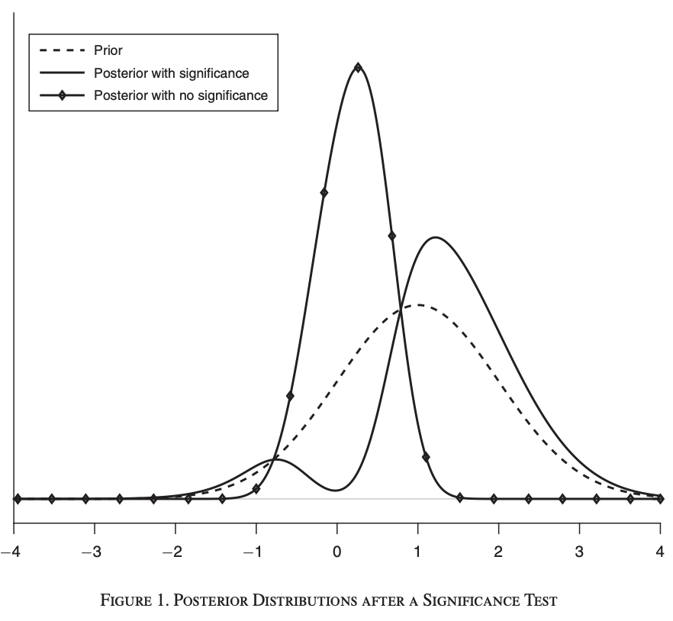
Null Result Ruling Out Inattention is Important & Informative
May have expected to work
(e.g. Stango & Zinman, 14 RFS; Alan, Cemalcilar, Karlan, Zinman, 17 JF)
What can we learn? Abadie (20 AERI)
“Rejection of a point null often carries very little information, while
failure to reject may be highly informative”

Slide 10
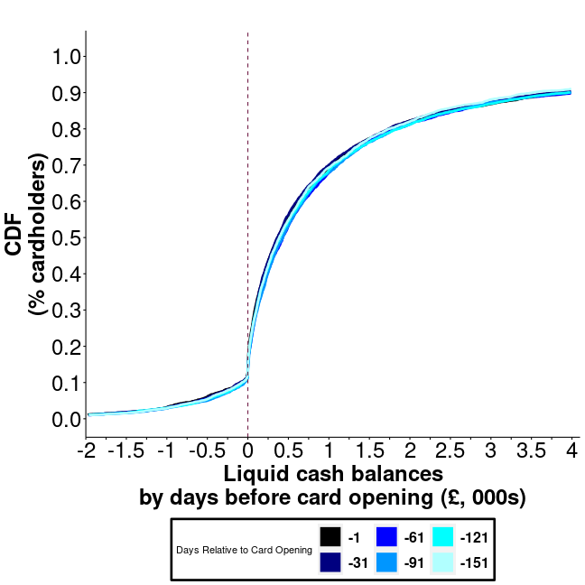
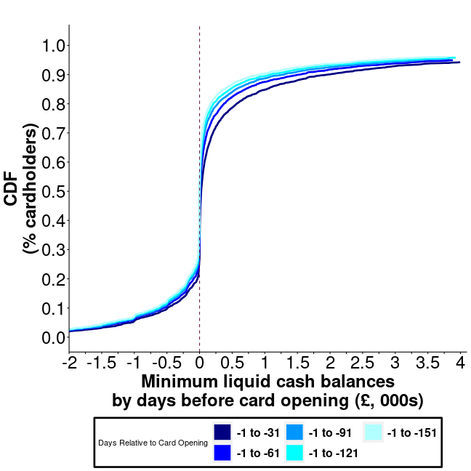
How to Measure Co-Holding? Consider intra-month dynamics
Liquid cash balances on 1 day
Minimum liquid cash balances over X days
Guttman-Kenney, Adams, Hunt, Laibson, & Stewart (23 WP)
- predicts future credit card spending.

Slide 11
Where next?
Policy
Nudges are not enough (Laibson, 2020 AEA)
Technological / regulatory solutions?
E.g. Auto-sweep, hard paternalistic credit card regulations
Research
Did co-holding change post-Durbin? (Mukharlyamov & Sarin,22 WP)
Mental accounting spending vs. repaying?
Debit cards as an imperfect mechanism to build savings?

Slide 12
Can AI solve puzzles?

Slide 13
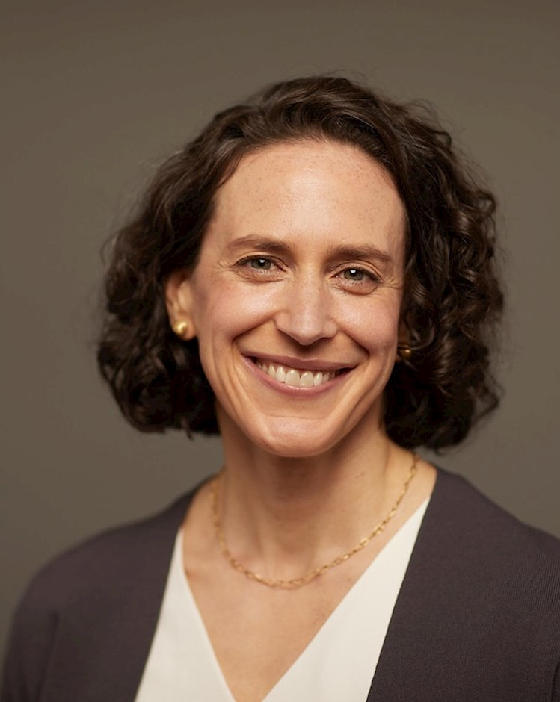
AI ABBY
1. Liquidity Needs
2. Uncertainty / precautionary
saving
3. Debt repayment strategy
4. Behavioral factors
5. Credit score considerations
6. High investment returns
AI PAOLINA
1. Supporting the investment
2. Brand loyalty
3. Perceived value
4. Emotional connection
5. Shareholder benefits

Slide 14
Thank You!

